Slide 1

Open-Source Lunch Bites
Thursday 17th September 2026

Slide 2
Introduction
Open-Source Lunch Bites is a series of 30-minute monthly (3rd Thursday) webinar lunch and learns designed to provide practical, bite-sized learning experiences.
Each session includes a presentation/demonstration with space for interaction and questions as necessary, focusing on Open-Source skills relevant to the pharmaceutical industry.
The webinars will have tied-in resources for ongoing learning.
Join us each month to enhance your Open-Source knowledge in a convenient, pocket-sized format.

Slide 3
Topics
Why Open-Source Skills are Important – PSI AIMS SIG Website
Coding
Debugging
Packages
GitHub
Containers
AI use
Suggestions?

Slide 4
So Far…
What is an IDE?
Debugging
Package Basics (parts 1 and 2)
Graphics Basics (parts 1, 2 and 3)
Code and presentations – website/lunchbites at main · PSIAIMS/website
Quick summaries – News – PSI AIMS SIG Website

Slide 5
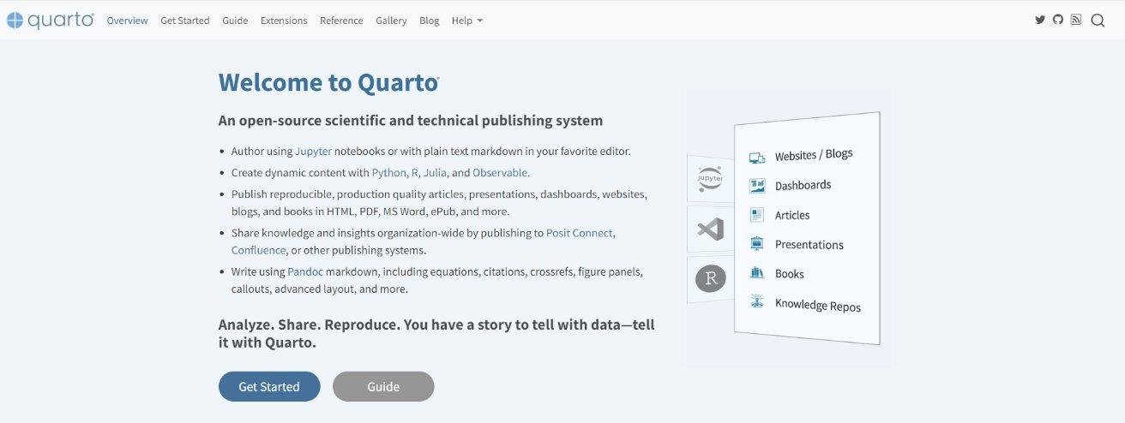
Quarto Basics
Link – Quarto
Quarto is a multi-language, next generation version of R Markdown from Posit, with many new features and capabilities.
R Markdown is fundamentally tied to R which severely limits the number of practitioners it can benefit.
Quarto is Posit’s attempt to bring R Markdown to everyone!
Quarto was developed to be multilingual, beginning with R, Python, Javascript, and Julia, with the idea that it will work even for languages that don’t yet exist.

